Slide 1
A1

Slide 2


Where Does Your Money Go?
Track expenses for one month
  What did you buy
  Which were needs vs. wants
  Patterns of spending
Categorize spending (clothing, food, etc.)
Identify future spending (car, etc.)
A2

Slide 3
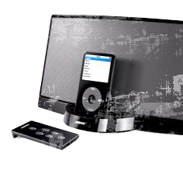
Why Budget?
Helps you to live within your financial
means and meet expenses
Helps you track spending versus saving to
accomplish long- and short-term goals
Offers peace of mind. Worry is a waste
of resources
A3

Slide 4

Ideas to Use
Pay yourself a weekly amount for spending money
If you get a lump sum grant or loan for the semester,
write the semester’s worth of rent checks
Use meal cards to plan your food costs
Save each day’s loose change to make a weekend
fun fund
Use phone cards to measure/manage phone expenses
A4

Slide 5

Creating a Budget to Meet Your Goals
Estimate income vs. expenses
Estimate future expenses
Factor in change
  New situations
  Conditions that change your expenses
Set money aside to meet your goals
Make adjustments as needed
A5

Slide 6

Creating a Budget to Meet Your Goals
Why set goals
Categorize goals
  Short term (during the college term)
  Medium term (during the academic year)
  Long term (through college and beyond)
Prioritize goals through college and beyond
Determine resources needed to accomplish your goals
Research options
A6

Slide 7
https://www.makeuseof.com/tag/ted-talks-see-money-new-way/
Video two One Life Changing Class You Never Took-Alexa Von Tobel

Slide 8

BUDGETING

Slide 9
BUDGETING
Parts of a budget
Income
Expenses
Difference between the two:
surplus or deficit
9

Slide 10
BUDGETING
Know what you spend
Keep every receipt.
Record every expense in a notebook
or electronic device.
Review bank and credit card statements.
Do this for at least three months.
Make a list of irregular expenses (gifts,
donations, car or home repairs, vacations).
Total your expenses at the end of
the month.
10

Slide 11
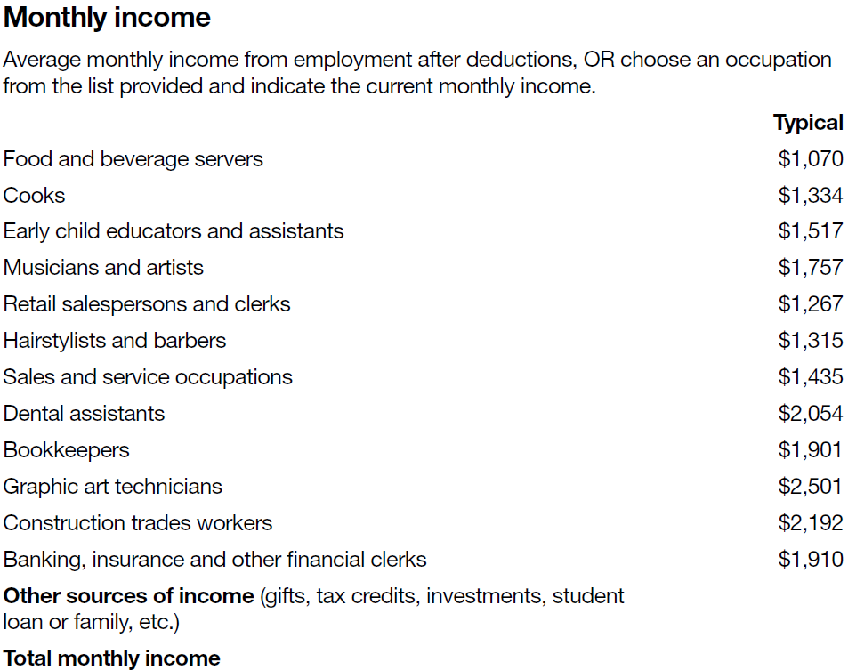
BUDGETING
Monthly income
11

Slide 12
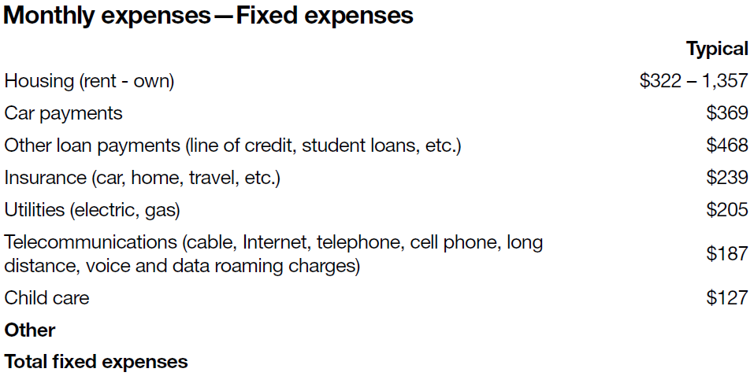
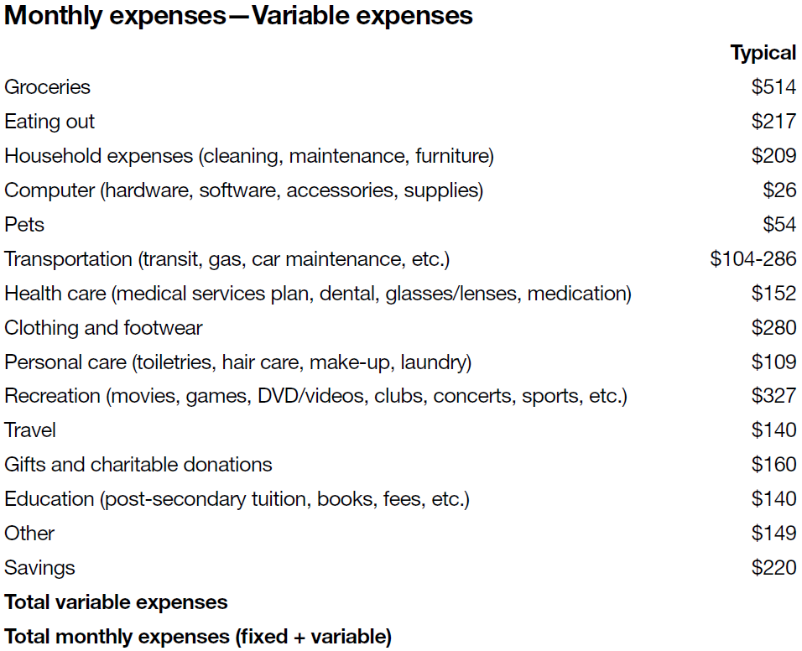
BUDGETING
Monthly expenses –
Fixed vs Variable expenses
12

Slide 13
BUDGETING
Net surplus or deficit
Difference between total monthly income and total monthly expenses =
Net surplus _______________
OR
Net deficit _______________
13

Slide 14
Activity: Tracking a Monthly Budget
Take a look at the costs, are there any others?

Slide 15
MANAGING YOUR COST
OF LIVING –
BE A SMART CONSUMER

Slide 16
MANAGING YOUR COST OF LIVING – BE A SMART CONSUMER
Areas for saving
Check your bills.
Negotiate better plans (banking fees and
services, telephone, cell phone).
Pack a lunch.
Consider whether you need to own a car,
a home or the latest high-tech gadget.
16

Slide 17
MANAGING YOUR COST OF LIVING – BE A SMART CONSUMER
Check your bills
Spot mistakes and overcharges.
Pay less in late fees, interest and penalties.
Get errors corrected before it’s too late.
17

Slide 18
MANAGING YOUR COST OF LIVING – BE A SMART CONSUMER
Negotiate better plans
Call each service provider and ask:
• How can I cut back my monthly bills?
• Am I currently on any plans?
• Do you have a better plan or deal for me?
• If so, what is the timeframe?
• Will I be put on contract for any new deals?
• Can I bundle services to save money?
• Can I avoid interest or late
payment penalties?
18

Slide 19
MANAGING YOUR COST OF LIVING – BE A SMART CONSUMER
Reduce banking costs
What am I paying in monthly
service charges?
How much am I paying for ATM fees?
Can I save by doing more banking online?
Am I eligible for a low-fee deal if
I’m a student?
Can I get a reduced fee if I keep a
minimum balance?
Can you suggest a better plan for me?
19

Slide 20
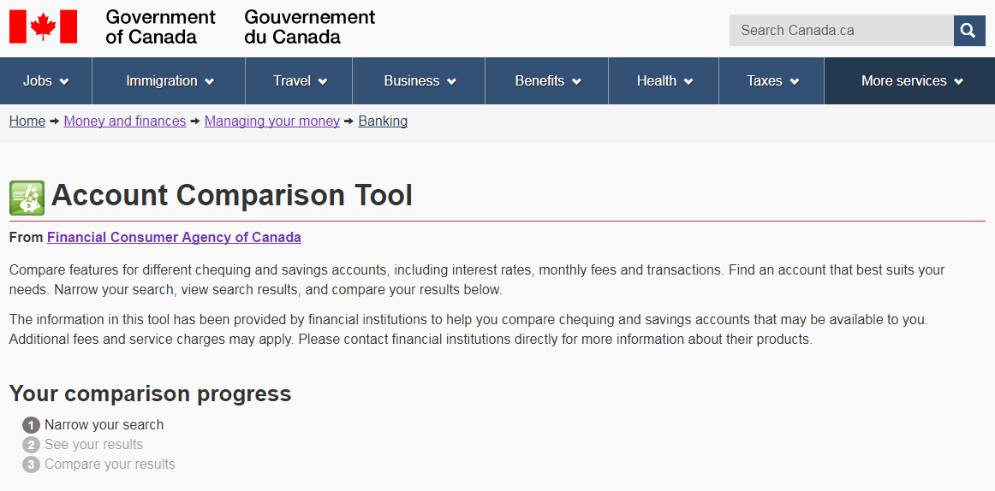
MANAGING YOUR COST OF LIVING – BE A SMART CONSUMER
Account Comparison Tool
20

Slide 21
MANAGING YOUR COST OF LIVING – BE A SMART CONSUMER
Compare phone costs
What am I paying for land line and
cell phone?
How much do my long-distance calls cost?
Can I bundle services together to save?
Can I switch suppliers to save money?
Do I have a contract? When does it expire?
Have I called suppliers to ask how to
cut costs?
21

Slide 22
MANAGING YOUR COST OF LIVING – BE A SMART CONSUMER
Bundling services pays
big time
You pay $25/month for home phone,
$30 for cell phone, $35 for Internet and
$40 for cable TV = $130
Example of bundling discounts:
  Combine 2 services, save 5%
  Combine 3 services, save 10%
  Combine 4 services, save 15%
Save 15% of $130 = $19.50 per month
22

Slide 23
MANAGING YOUR COST OF LIVING – BE A SMART CONSUMER
How to save on food
Eat breakfast at home.
Bring your lunch, drinks, snacks, and coffee.
“Veg out” on meatless meals once a
week or more.
Cook one big dish on weekends and freeze.
Shop with a buddy at discount supermarkets
and split quantities.
Set a budget and stick to it.
Bring a list and don’t shop on an
empty stomach.
23

Slide 24
MANAGING YOUR COST OF LIVING – BE A SMART CONSUMER
Do you really need a car?
Add up the real costs of ownership (gas, insurance, depreciation, interest and maintenance).
Check out FCAC’s content on Financing a car
  www.canada.ca/money, click on Debt and borrowing, click on Loans and lines of credit, click on Financing a car
Try the Vehicle Lease or Buy Calculator
  www.canada.ca/financial-tools, click on Vehicle Lease or Buy Calculator
24

Slide 25
MANAGING YOUR COST OF LIVING – BE A SMART CONSUMER
When owning a home doesn’t make sense
When you move frequently:
  It takes at least five years to make
  it worthwhile.
If you have a very low down payment:
  You’ll need mortgage default insurance.
  You may have a higher interest rate.
When your income covers only mortgage
payments and taxes.
25

Slide 26
MANAGING YOUR COST OF LIVING – BE A SMART CONSUMER
Can you afford it?
Try it out:
  Put the monthly costs of owning a home
  (mortgage, property taxes, maintenance,
  etc.) into a savings account.
  Can you afford to live on what’s left?
  Could you afford higher costs for heating,
  taxes or insurance?
Rent or Buy a Home Calculator
  www.ic.gc.ca, select Just for consumers, select More, select Office of Consumer Affairs (OCA), click Spending Smarter Tools
26

Slide 27
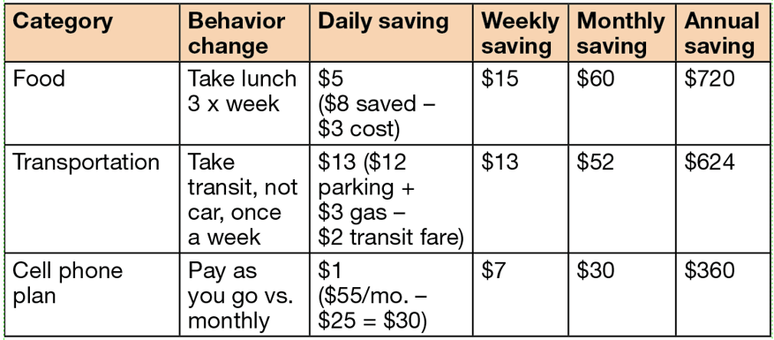
MANAGING YOUR COST OF LIVING – BE A SMART CONSUMER
How to cut $142/month
of spending
27

Slide 28
Why It’s Important
Following a practical budget can help you:
1. Develop better financial habits.
2. Relieve emotional stress.
3. Assist you in achieving your financial goals.

Slide 29
Why is a Budget Necessary?
Identifies and defines your financial goals
Manages your money
Directs your money flow
Increase your savings
Avoids spending money unnecessarily
Achieves your personal goals

Slide 30
What is a Budget?
“…a plan for the coordination of resources and expenditures”
Merriam-Webster Online Dictionary
Simply Put:
A budget is a plan for managing your money in a way that best meets your personal needs and wants.

Slide 31
Seven Keys to Effective Budgeting
Identify and develop personal goals
Evaluate and record current trends, both income and expenses
Assign priorities
Develop a time line for the month
Keep it simple
Remain flexible: “One size does not fit all”
Review and revise

Slide 32
Budgeting is Effective Money Management
Effective money management is planning how to get the most from your money.
Good money managers keep track of where their money goes so that they can make it go farther.
Effective money management includes:
  Developing personal financial goals
  Organizing personal financial records
  Creating a personal monthly budget
  Evaluating personal financial health

Slide 33
How do I Create a Budget?
Creating a budget begins with a clear, accurate, and well-thought-out plan. This will allow you to be able to:
Adjust plans, activities, and spending as needed
Spend money cost-effectively
Reach the specific goals you have set
Strengthen internal control system

Slide 34
What’s in a Budget?
INCOME
Simply any money earned or contributed to your household from either personal finances or a business.
EXPENSES
Money that you spend, this includes anything you purchase. This includes both planned and unexpected expenses.

Slide 35
Steps in Budgeting
Set financial goals
Estimate your income
Record what you spend
Budget for actual and unexpected expenses
Review and evaluate monthly

Slide 36
Set Financial Goals
Identify and write them down
  Long term (1-5 years)
  Short term (within a year)
Make then achievable, practical, and owned by everyone
  Keep them in the fore front
  Journal the process
  Celebrate their completion
Write them into your monthly budget
Adjust them as necessary

Slide 37
Estimate Your Income
Make a list of each income stream that you receive on a regular basis each month. The key is to only include that income you get every month.
Include both monthly wages earned from your job(s) as well as monthly supplemental income (i.e. child support, disability, etc.)
Mark down the date these are received
Calculate the monthly income total
Record, but do not include any periodic income you may receive at this point.

Slide 38
Estimate Your Income
If your income is unpredictable, estimate what you will receive in the next month and adjust it DOWN a little

Slide 39
Record What You Spend
Review the previous month’s check book ledger, bank statements etc. and record your spending and income.
Record what you spend for the next month and write down what your actual expenses and income

Slide 40
Budget for Actual and Unexpected Expenses
Actual Expenses:
  Identify fixed expenses (i.e. rent, car payment, student loans).
  Record the monthly payment deadline and plan according to your payday date.
Variable Expenses:
  Identify recurring expenses the fluctuate (monthly grocery, automobile, etc.) calculate an average based on previous months NOTE: when in doubt, guess high!
  Consult with friends and family on what they spend

Slide 41
Actual Expenses
Rent or Mortgage
Car – payment, upkeep, gas, etc.
Insurance (health/medical, life, auto, home, et.)
Food
Household utilities
Clothing
Entertainment

Slide 42
What Else is in a Budget?
Student loan payments
Insurance payments
Entertainment (movies, books, magazines, toys, cable TV, Internet access)
Income taxes in addition to those withheld from your paycheck
Child care
Medical bills
Savings (transfers to savings account, retirement fund or brokerage account)
Vacations

Slide 43
Budget for Actual and Unexpected Expenses
The FIRST step is to create and maintain an Emergency Fund.
Initially the Emergency Fund should be $500 - $1, 000 depending on your income and debt load.
Eventually you need to increase this to 3-6 months worth of income.
Develop the attitude that this is ONLY used for EMERGENCIES (unemployment, unexpected medical needs or any other financial crisis).
Should you have to use money in this fund for an EMERGENCY the priority for the next month is to re-supply the fund.
Remember Murphy always strikes!

Slide 44
Video
https://www.makeuseof.com/tag/ted-talks-see-money-new-way/
Video three
Sell your crap, pay your debt, Adam Baker

Slide 45
Budget Resources
Use these resources for additional information:
http://www.stats.bls.gov/news.release/cesan.toc.htm
http://www.practicalmoneyskills.com
http://consumerist.com/consumer/tools/the-zero-based-budget-300076.php

Slide 46
Review & Evaluate
Review on a monthly basis, especially when you begin the process.
Evaluate the budget against your personal financial goals.
All monthly deficits need to be addressed immediately
All surplus experienced needs to be added to savings
Consider operating on a cash envelope system
Do not get discouraged.

Slide 47
Practical Budgeting Tips
The budget must BALANCE
  The income must equal the expenses. If you make, you must have a ‘destination ‘for that money!
  That does NOT mean you MUST SPEND it. Planning to put money in some type of savings account is a GREAT idea.
  The Income MUST EQUAL Expenses!!
Plan carefully
  estimates should be based on some data
  cover all expenses
Be practical
Be flexible
Write your budget down
Be able to access your budget data easily

